Slide 1
FIT1047 Week 8 Forum
Introduction to Computer Systems, Networks and Security

Slide 2

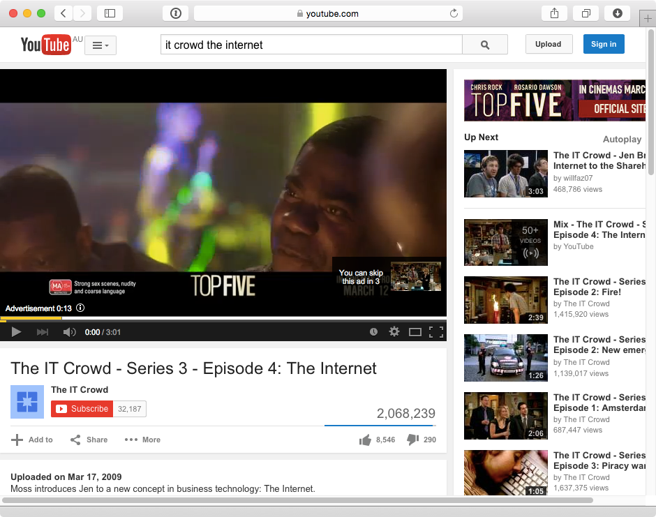
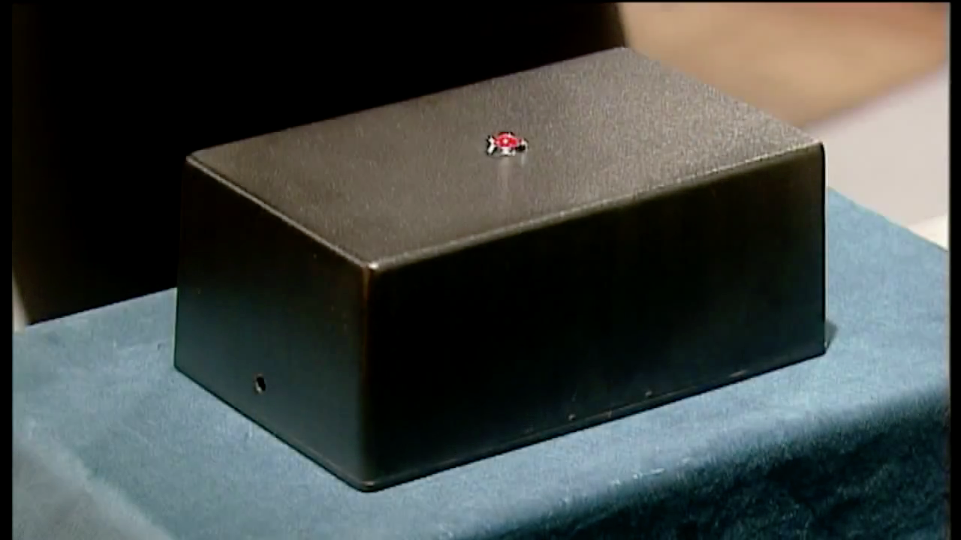

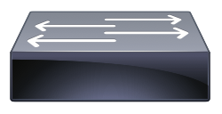

Abstraction of Layers
Briefly discuss the following diagram
Switch
Router
Switch

Slide 3
Physical Layer – Network Cables
Discuss different types of network cables.

Slide 4
Physical Layer – Physical Media and Transmission Types
Discuss the digital and analog signals vs digital and analog data.

Slide 5
Physical Layer – Digital Transmission
Discuss various digital transmission: Unipolar, polar, non-return-to-zero, return-to-zero, Manchester encoding.

Slide 6
Physical Layer – Analog Transmission
Discuss analog transmission of AM, FM and PM.

Slide 7
Physical Layer – Analog Transmission
Discuss analog transmission of AM, FM and PM.

Slide 8
Network Layer – Addressing Devices
List down the main functionalities of network layer.

Slide 9
Network Layer – Subnetting
Explain the importance of subnetting.

Slide 10
Network Layer – IPv4
Explain the format of Ipv4.
255.255.240.0
11111111.11111111. 11110000.00000000
196.168.249.10
11000100. 10101000. 11111001.00001010
196.168.244.225
11000100. 10101000. 11110100.11100001

Slide 11
Network Layer – IPv4 vs IPv6
Compare Ipv4 and IPv6 in terms of address space and format. Outline the IPv6 format.

Slide 12
Network Layer – Routers
State the functions of a router. What is routing table in the router?

Slide 13
Network Layer – Routing
Describe distance vector and link state routing.

Slide 14
Network Layer – Address Resolution (ARP)
Define address resolution. How to perform address resolution at Application Layer and at Data Link Layer.

Slide 15
Transport Layer – TCP vs UDP
Compare and contrast the two important transport layer protocols, TCP vs UDP

Slide 16
Transport Layer - Addressing Application
List down the main functionalities of transport layer.

Slide 17
Transport Layer – Flow and Error Control
Explain how TCP ARQ works for the three phases of a TCP session.

Slide 18
Application Layer – Application Architectures
Describe the application architecture and list down six types of architectures.

Slide 19
Application Layer – WWW, HTTP, HTML, URL
Briefly describe WWW, HTTP, HTML, and URL.

Slide 20
Application Layer – HTTP Session
Briefly describe an HTTP session. HTTP is a stateless protocol, how HTTP keeps track of the users’ browsing history?

Slide 21
Application Layer – SMTP
Briefly describe how SMTP is used for two-tier and three-tier mail.

Slide 22
Application Layer – MIME
What is the purpose of using MIME in email?

Slide 23
Data Link Layer – Functions
Briefly outline the functions of data link layer.

Slide 24
Data Link Layer – Ethernet Protocol
Give one example of data link layer protocol and discuss how the protocol works.

Slide 25
Data Link Layer – Switched Ethernet
Discuss how the switched Ethernet works and how it is better than classical Ethernet.

Slide 26
Data Link Layer – WLAN – Radio Frequencies
Sketch and describe 2.4GHz of Wi-Fi frequency. Compare this band with the 5GHz band. What is interference and how to avoid interference? What is attenuation?

Slide 27
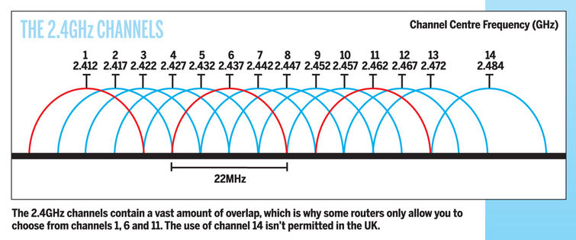
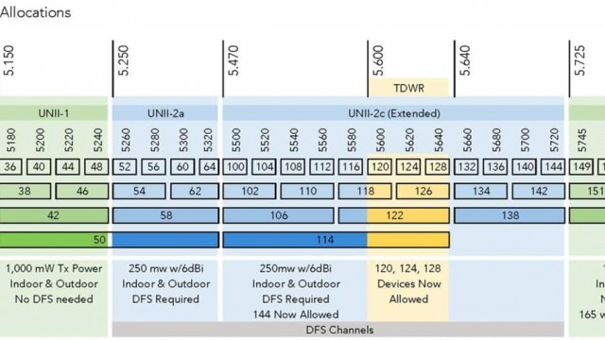
Data Link Layer – WLAN – Radio Frequencies
Sketch and describe 2.4GHz of Wi-Fi frequency. Compare this band with the 5GHz band. What is interference and how to avoid interference? What is attenuation?

Slide 28
Data Link Layer – BSS and ESS
Briefly describe the architectures of BSS and ESS.

Slide 29
Data Link Layer – WLAN – CSMA/CA
Sketch and describe the working principle of CSMA/CA in WLAN. Discuss how CSMA/CA used to avoid collision.

Slide 30
Data Link Layer – WLAN – CSMA/CA and ARQ
What is the main problem of CSMA/CA and how to overcome this problem?

Slide 31
